Slide 1
Proposal for Association as
Thomso’23 Partner

Slide 2

Subject: Association between Durian and Thomso'23, IIT Roorkee.
Indian Institute of Technology, Roorkee, situated at the foothills of the great Himalayas, is the oldest technical institute for higher studies in all of Asia.
Established as Thomason College of Engineering in the
year of 1847. It carries with it rich history and responsibility as one of the most reputed technical institute in India.
IIT Roorkee invites Durian to associate with Thomso, the Annual Cultural Festival of IIT Roorkee, deemed as the Youth Festival of Uttarakhand by the government. It is among the most recognisable college fests in India and every year attracts a ginormous crowd of over 100,000 students from more than 500 colleges across the length and breadth of the country including the country’s best institutes and universities.

Slide 3

THOMSO AT A GLANCE

Slide 4
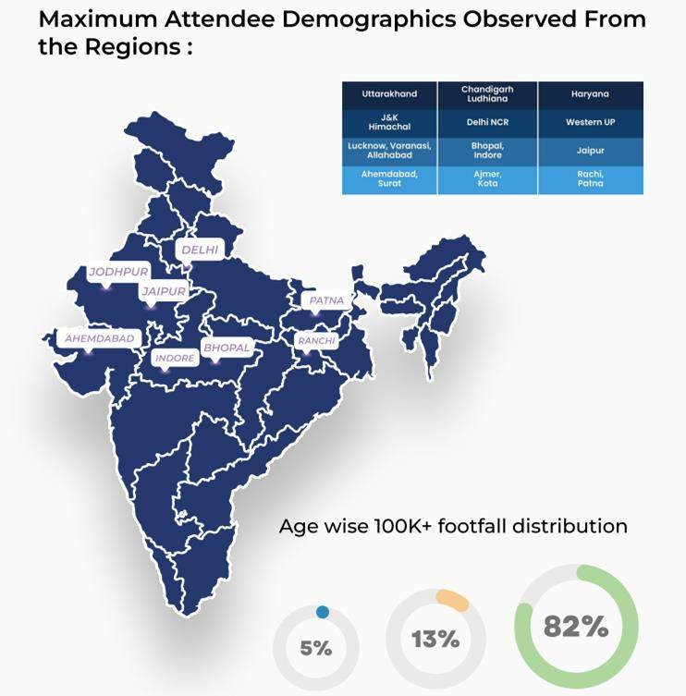
UTTRAKHAND
UTTAR PRADESH

Slide 5

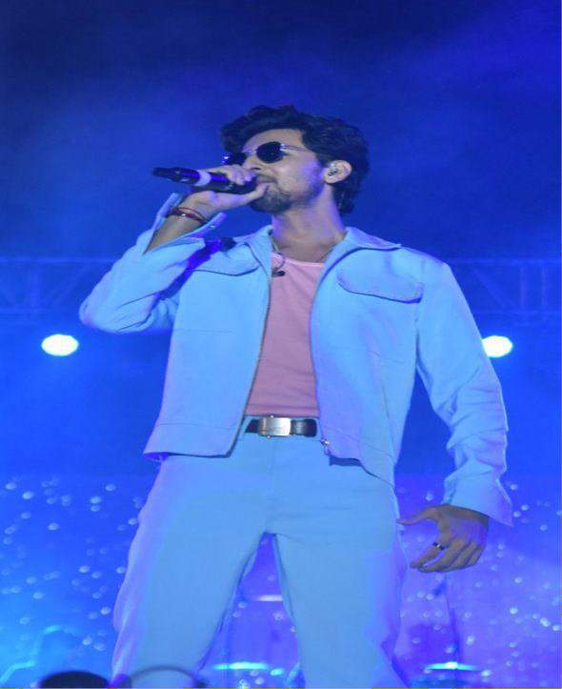
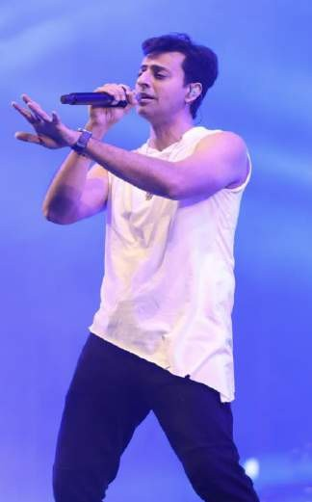
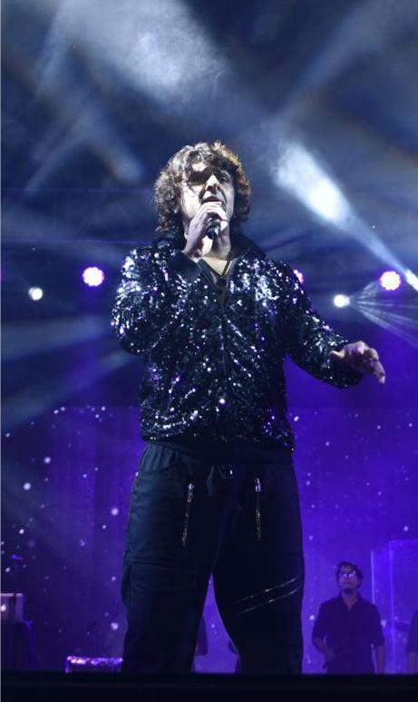
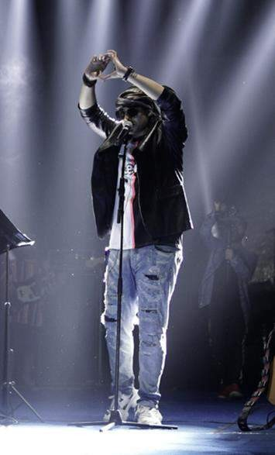
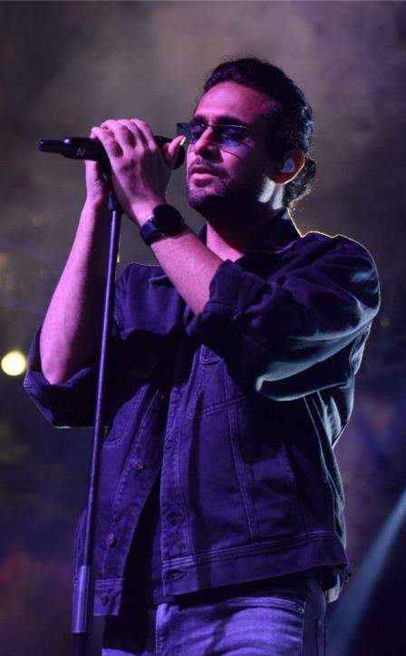
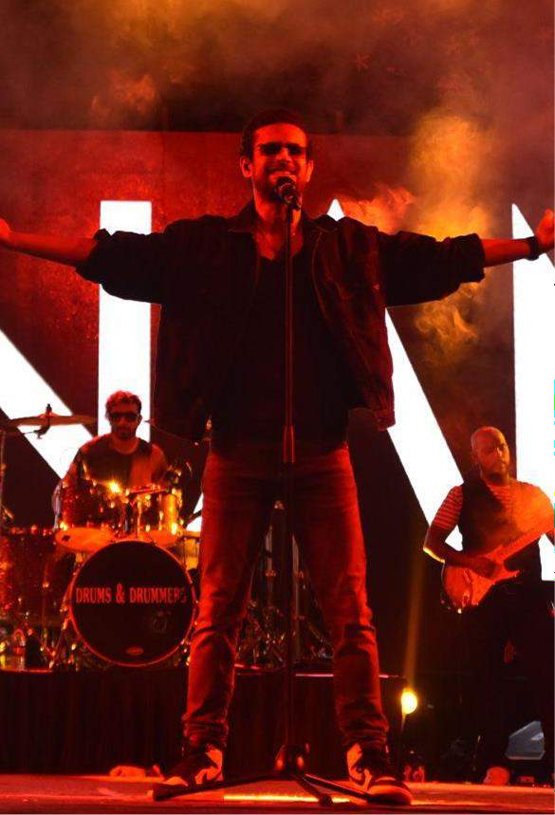

GLIMPSES OF PRONITE

Slide 6



WHAT WE OFFER

Slide 7
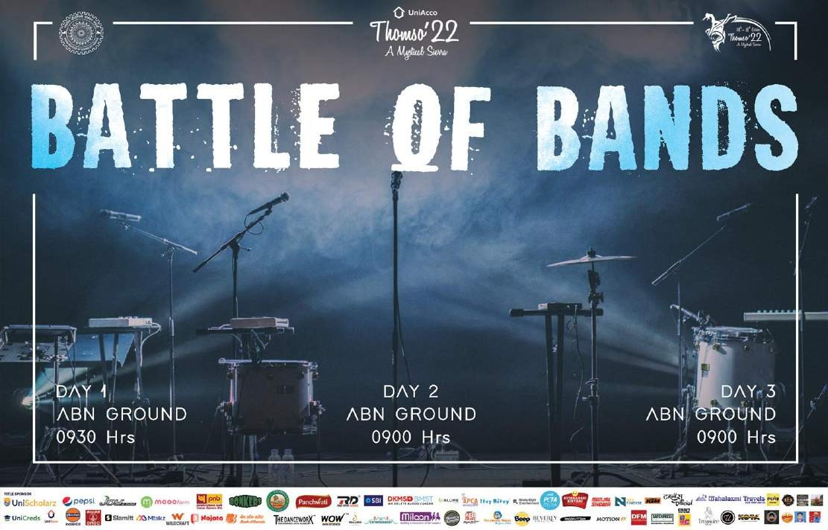
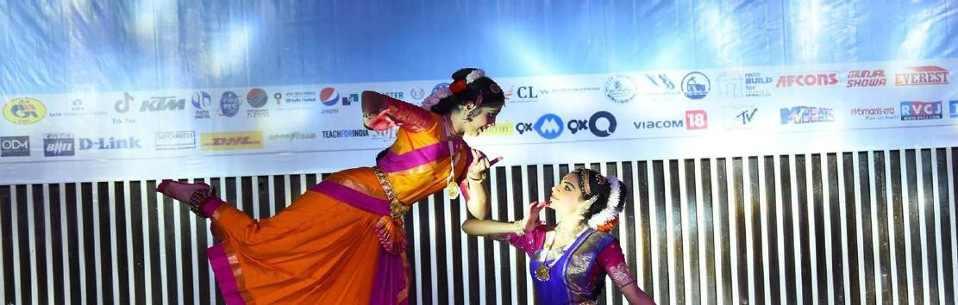
Backdrops of all the events will carry Durian as
“Thomso’23 Partner.”

Slide 8
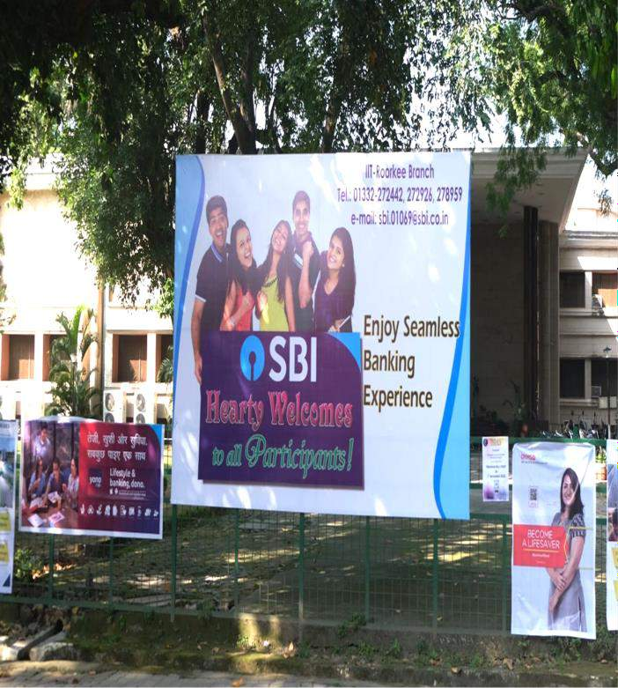
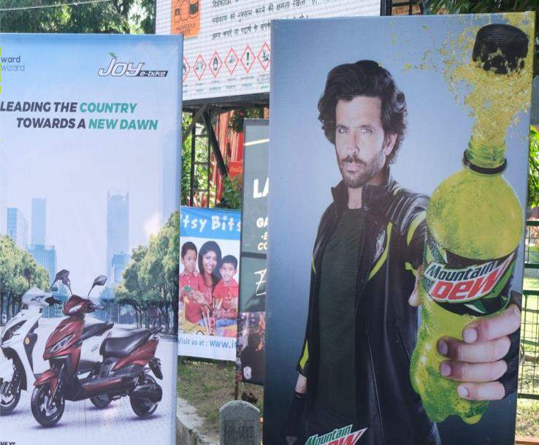
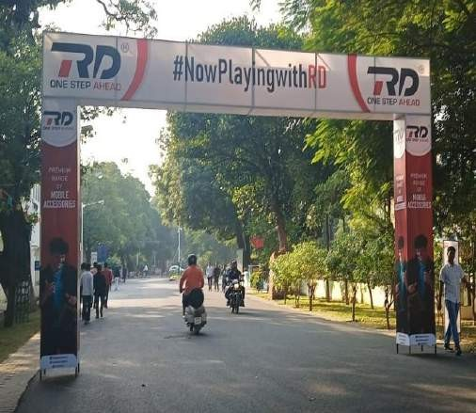
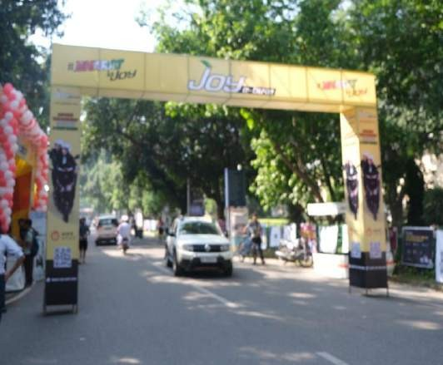
Flexes and banners of varying sizes and standees will be placed at different hotspots across the campus, throughout the 3-day festival.
Gate featuring Durian at a major junction on Campus

Slide 9
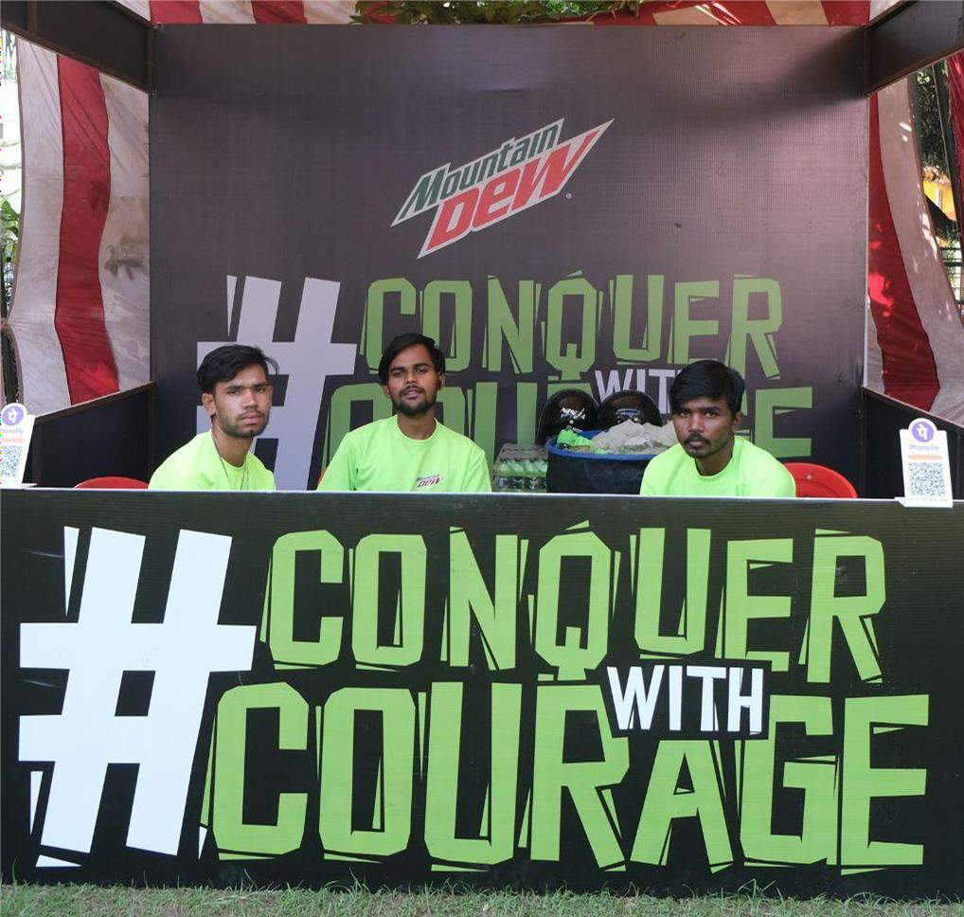
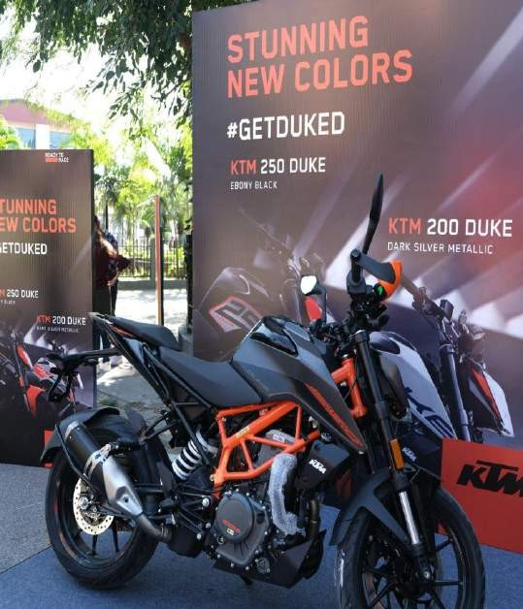
An exclusive stall (2*1.5 sq m) at vital location across the campus: UG club/Convocation hall with permission to display exclusive banners/ﬂexes/backdrops at these locations.
At 100K+ footfall, Durian can effectively engage the crowd and promote their brand by actually showcasing their product at our fest.

Slide 10
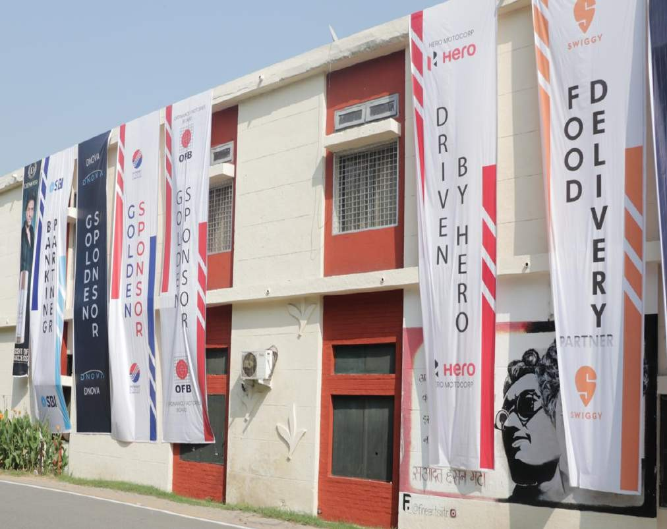

Dropdowns shall be installed at prime locations across the campus (LHC, SAC, MAC, Rajiv Bhawan, Ravindra Bhawan etc.).

Slide 11
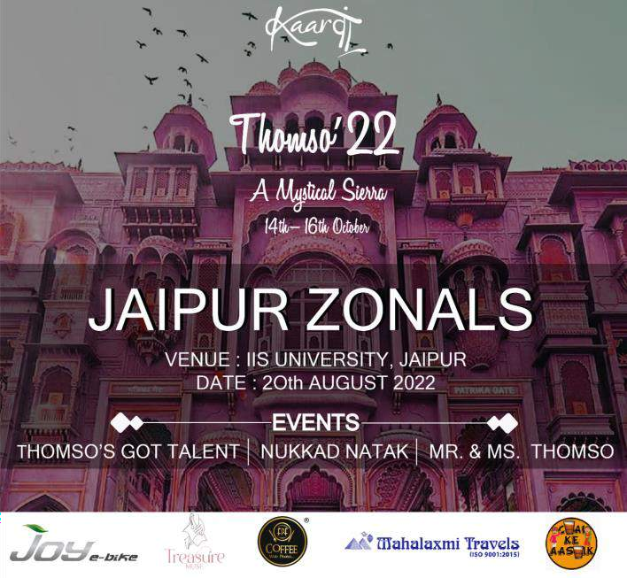
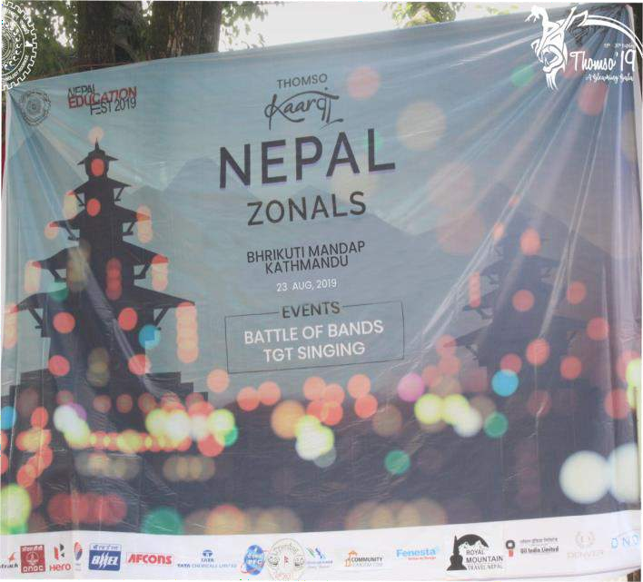
Branding in Zonals
Thomso hosts one-day mini Thomso events with cultural competitions in Indian cities like Dehradun, Jaipur, Delhi, Bengaluru, Chandigarh, and Lucknow.
Durian will be our Zonal Partner and will feature in all
zonal programs, events, and competitions.
Durian will have a dedicated standee and promotional teaser/ trailer/ advertisement of the brand will be shown during the main events.
Zonals offer a unique opportunity to reach a vast audience of participants from different parts of India.

Slide 12
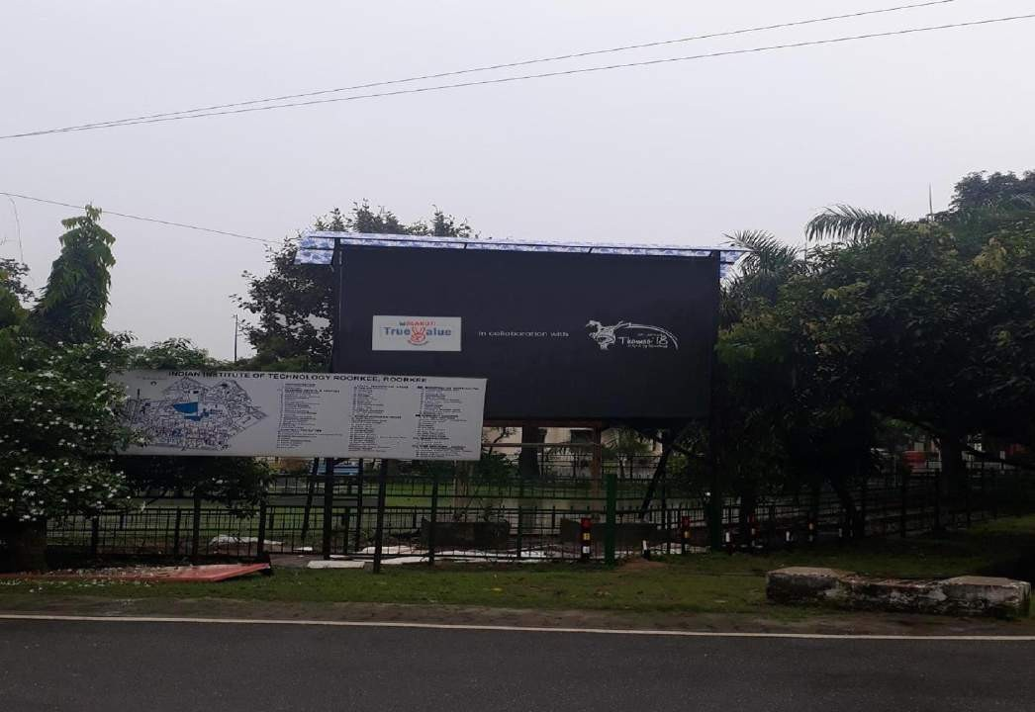
Branding and Marketing of Durian through Digital Display Boards installed in IITR Campus during and after the Fest:
It is the most frequently visited place by students, faculty and staffs with an average daily footfall of 30,000.

Slide 13



Online Promotions in the form of posters released on our social media handles and the official website of Thomso.

Slide 14
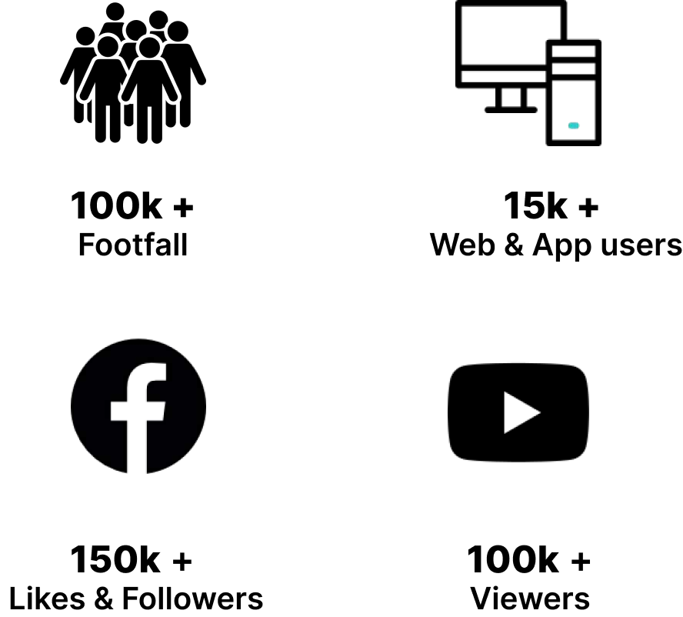
Online Branding and marketing of Durian:
Durian will be presented as Sponsor in all of the advertisements featured by 50+ official media partners (digital, social media, television, magazine).
Online events and social media posts by Thomso'23 featuring the logo of Durian.
Promotional posts from our own social media
handles (Facebook, Instagram, Youtube)

Slide 15
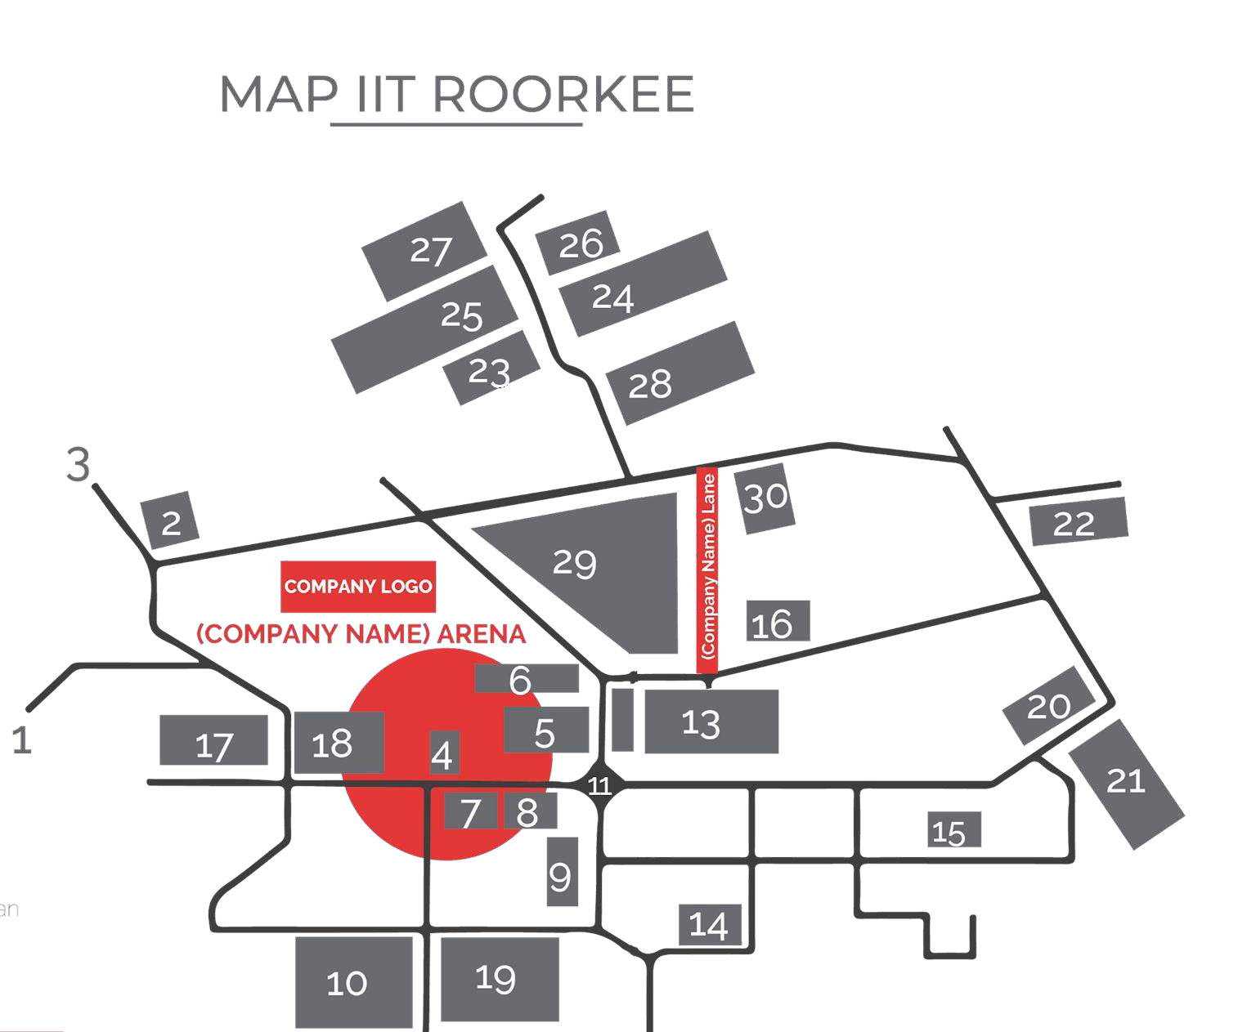

EXCLUSIVE BRANDING
A part or lane of the campus will be named after Durian and this will be reflected on the official app, website and the Thomso Itinerary will be handed out to all the participants.
Main Gate
Convocation
Century Gate
LHC
DoMS
Central Library
Georgia 8 . UG Club
Hobbies Club
IIT Hospital
ECE Circle
Senate Hall
Main Building
Bose Auditorium
OP Jain Auditorium
Open Air Theatre
Azad Bhawan
Ravindra Bhawan
Govind Bhawan
Sarojini Bhawan
Jawahar Bhawan
Kasturba Bhawan
Rajiv Bhawan
Cautley Bhawan
Rajendra Bhawan
Radhakrishnan Bhawan
Ganga Bhawan
Multi Activity Hall
ABN Ground
Saraswati Mandir G.

Slide 16




Posts featuring the sponsor

Slide 17

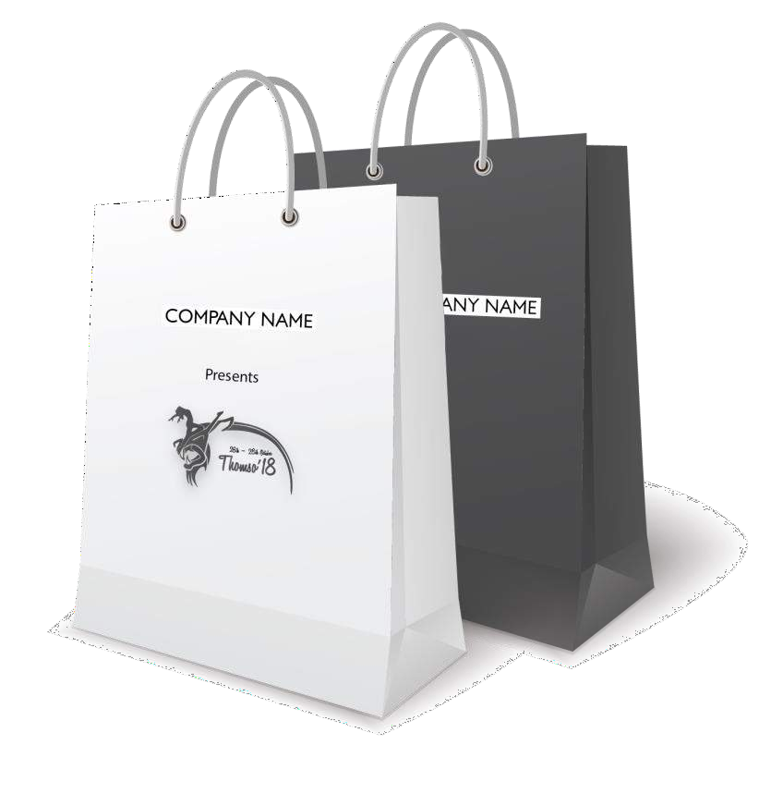
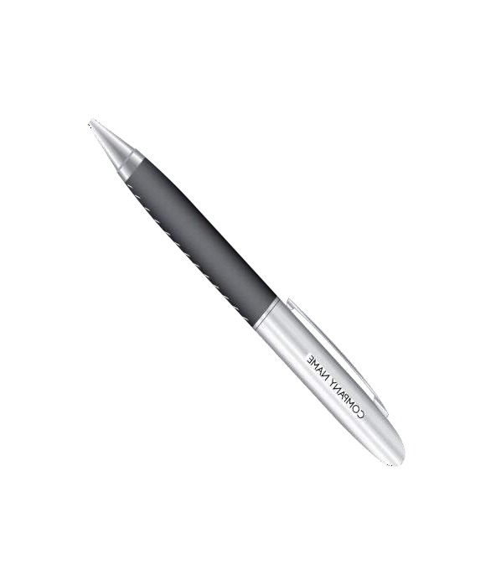
Tshirts with Durian logo on it will be distributed by Thomso to Winners, Participants, Co-ordinators and Volunteers.

Slide 18
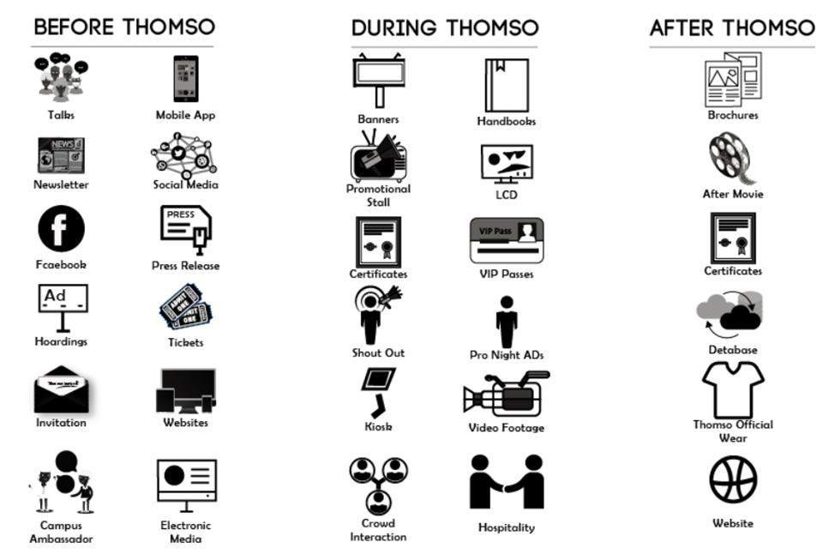
Opportunities by THOMSO to
Durian

Slide 19
Summary of deliverables by THOMSO to Durian:
Thomso’23 will provide Durian with Thomso'23 Partner* rights this year.
Flexes of different sizes featuring Durian will be put, covering every roundabout and prime location in the campus.
Backdrops of all the events will carry Durian as
Thomso'23 Partner.**
Thomso will display Durian’s logo on its official website in the sponsor section.
An exclusive stall (2*1.5 sq m) at vital location across the campus: UG club/Convocation hall with
permission to display exclusive
banners/ﬂexes/backdrops at these locations.
Online promotions from our dedicated social media
handles in the form of posts and marketing videos.
*Please note that the title Thomso’23 Partner will be changed accordingly to Diamond, Platinum, Gold or Major Sponsor. For more details, please refer Pg. 22 of this PDF.
**Further, additional titles of association like Fitness Partner, Health Partner etc. can also be given based on mutual agreement.

Slide 20
Summary of deliverables by THOMSO to Durian:
Distinctive mention of Durian in our souvenir which is sent all over India to 500+ companies and 1000+ colleges/universities.
Exclusive announcements promoting Durian as a Thomso'23 Partner.
Thomso will act as Digital Branding partner for Durian.
Durian name and logo will be publicized on posters
and invitation brochures, to be sent across 1000
colleges in the country.
Separate E-Ricks with banners of “Durian” covered all over them will run across the campus ensuring maximum reach and visibility.
Promotional video/Advertisement featuring Durian
will be shown during our flagship events.

Slide 21
Summary of deliverables by THOMSO to Durian:
Durian will be given special mention in Thomso’23
aftermovie.
Permission to conduct workshops in the campus before and during the fest.
Title Partner rights of certain events that can be discussed mutually.
Tshirts with Durian logo on it will be distributed by Thomso to Winners, Participants, Co-ordinators and Volunteers.
We are open to making Special arrangements that can be discussed according to the marketing strategy of Durian.

Slide 22
Deliverables | 5 Lakhs | 3.5 Lakhs | 2 Lakhs | 1 Lakh
 | Diamond | Platinum | Gold | Major
Flex/Banners | 20 | 15 | 10 | 6
Website | Yes | Yes | Yes | Yes
Standee | Yes | Yes | Yes | Yes
Social Media | Yes | Yes | Yes | Yes
Poster Logo Branding | Yes | Yes | Yes | Yes
Feature in Aftermovie | Yes | Yes | Yes | Yes
Logo on Events Backdrop | Yes | Yes | Yes | Yes
Digital display | Yes | Yes | Yes | Yes
Ads in Souvenir | 1 Page Ad | 1/2 Page Ad | 1/4 Page Ad | Logo Only
Zonal Branding | Yes | Yes | Yes | No
Stalls | Yes | Yes | Yes | No
Pamphlet in hand | Yes | Yes | Yes | No
Workshop | Yes | Yes | No | No
Marketing video | Yes | Yes | No | No
Ad during events | Yes | Yes | No | No
Naming Lanes of IITR | Yes | Yes | No | No
Gate | Yes | No | No | No
Dropdown | Yes | No | No | No
Event Title | Yes | No | No | No
E rickshaw | Yes | No | No | No
Merchandise/ T-shirt Branding | Yes | No | No | No

Slide 23
Deliverables from Durian:
Exclusive merchandise and products of Durian to be given to the winners/participants of various events.
Delivering the prints covering all company specific banners/ flexes/ backdrops for the events to be held during Thomso'23.
Details concerning promotional events and talks have to be specified clearly well in advance.
*Thomso team assures you that the above mentioned deals would be beneficial to both the parties. We look forward to hearing positively from you soon.
*Deliverables are negotiable from both side.

Slide 24





























Our Proud Sponsors

Slide 25









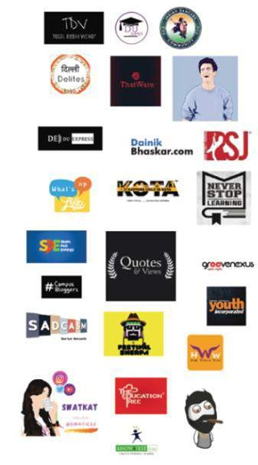






Our Previous Proud Associates
Event Partners
Magazine Partners
Digital Media Partners
Zonal Partners
News Paper partners
Banking Partner
co sponsors
Major sponsors

Slide 26
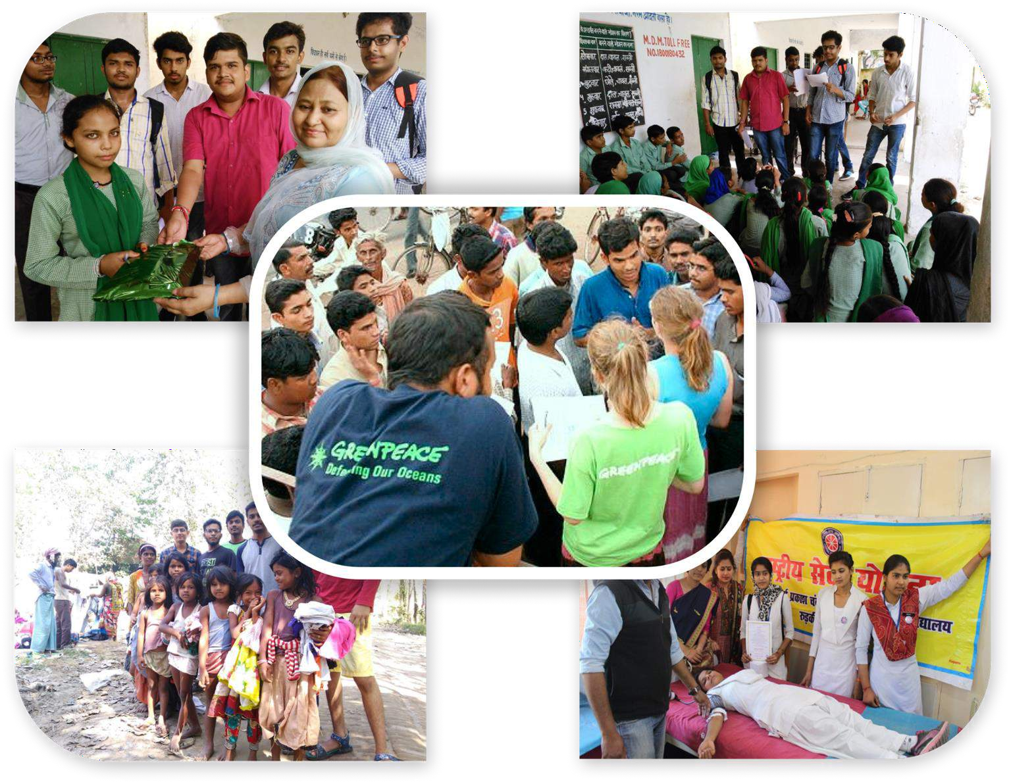
Thomso organised various social event in association with
NGO like:
PETA India ❏ DKMS BMST
MILAAN Foundation ❏ Greenpeace

Slide 27




THANK YOU for your time and consideration. We are eagerly looking forward to a long lasting relationship between Thomso, IIT Roorkee and Durian.
Yours Sincerely, Chinmay Nagpal
Team Member, Thomso’23
IIT Roorkee
Contact- +91 9654110696
Email id:- chinmay.thomso@gmail.com
Ayush Goyal
Team Member, Thomso’23
IIT Roorkee
Contact:- 7976400427
Email id :- ayushgoyal.thomso@gmail.com
Website
Instagram
Facebook
Youtube
Ayushgoyal.thomso@gmail.com

